Slide 1
Lecture 2: Relational Database Design
Features of Good Relational Design
Atomic Domain and First Normal Form
Function Dependency and Inferencing
Normalization
Functional Dependency Theory
  Closure of a Set of Functional Dependencies
  Lossless join decomposition
Algorithms for Functional Dependencies
  Decomposition Algorithms Using Functional Dependencies
Decomposition Using Multivalued Dependencies
Database-Design Process
Modeling Temporal Data
Notes:
In general, the goal of relational database design is to generate a set of relation schemas that allows us to store information without unnecessary redundancy, yet also allows us to retrieve information easily.
This is accomplished by designing schemas that are in an appropriate normal form.
We introduce a formal approach to relational database design based on the notion of functional dependencies.
We then define normal forms in terms of functional dependencies and other types of data dependencies.
First, however, we view the problem of relational design from the standpoint of the schemas derived from a given entity-relationship design.

Slide 2
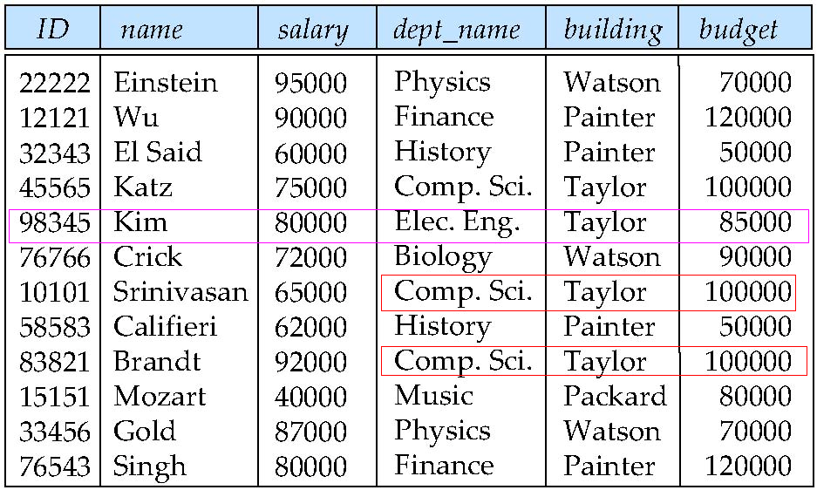
Larger/Combined Schemas?
Two schemas:
instructor (ID, name, dept_name, salary)
department (dept_name, building, budget)
Suppose we combine instructor and department into inst_dept as follows:
Result is possible repetition of information (the amount of budget)
If we delete Kim, Elec. Eng. Department will lost
Repetition/Duplicate
Notes:
This will create inconsistency.
This suggests that using inst dept is a bad idea since it stores the budget amounts redundantly and runs the risk that some user might update the budget amount in one tuple but not all, and thus create inconsistency.

Slide 3
Disadvantage of Large/Combine Schemas
Update anomalies:
  Modifying the budget in one tuple but not all tuples leads to inconsistency.
  Cannot insert a new department until the first instructor is hired
    ID is part of PK.
  Deleting the last instructor will lose the department information
    Without Kim, there is no department information (Elec. Eng.).
    Without Mozart, there is no department information (Music).

Slide 4
What About Smaller Schemas?
Suppose we had started with inst_dept. How would we know to split up (decompose) it into instructor and department?
  Intuition: put “strongly-related” attributes in the same relation
Write a rule: “every department (identified by its department name) must have only one building and one budget value”.
Denote as a functional dependency:
dept_name → building, budget
In inst_dept, because dept_name is not a candidate key, the building and budget of a department may have to be repeated.
  This indicates the need to decompose inst_dept

Slide 5
What About Smaller Schemas?
Not all decompositions are good. Suppose we decompose
employee(ID, name, street, city, salary) into
employee1 (ID, name)
employee2 (name, street, city, salary)
The next slide shows how we lose information -- we cannot reconstruct the original employee relation -- and so, this is a lossy decomposition.

Slide 6

A Lossy Decomposition

Slide 7
Example of Lossless-Join Decomposition
Lossless join decomposition
Decomposition of R = (A, B, C)
R₁ = (A, B) R₂ = (B, C)
A
B
C
A
B
B
C
α
β
1
2
A
B
α
β
1
2
1
2
A
B
r
∏_{A,B}(r)
∏_{B,C}(r)
∏_{A} (r) ∏_{B} (r)
A
B
C
α
β
1
2
A
B

Slide 8
Goal of Normalization
Decide whether a particular relation R is in “good” form.
  1NF, 2NF, 3NF, BCNF, etc
In the case that a relation R is not in “good” form, decompose it into a set of relations {R₁, R₂, ..., R_{n}} such that
  Each relation is in good form
  The decomposition is a lossless-join decomposition
The normalization theory is based on functional dependencies
  Constraints requiring that the value for a certain set of attributes determines uniquely the value for another set of attributes.
  A functional dependency is a generalization of the notion of a key.

Slide 9
Atomic Domain and First Normal Form
Domain is atomic if its elements are considered to be indivisible units
  Examples of non-atomic domains:
    Set of names, composite attributes.
A relational schema R is in first normal form if the domains of all attributes of R are atomic.
Non-atomic values complicate storage and encourage redundant (repeated) storage of data.
  Example: Set of accounts stored with each customer, and set of owners stored with each account.
  We assume all relations are in first normal form. (It is not required in Object Based Databases.

Slide 10
Atomic Domain and First Normal Form
Non-1NF should be normalized.
ID | Name | Phone_number
1 | John | {6601, 6602}
ID | Name
1 | John
ID | Phone_number
1 | 6601
1 | 6602

Slide 11
Atomic Domain and First Normal Form
Atomicity is actually a property of how the elements of the domain are used.
  Example: Strings would normally be considered indivisible
  Suppose that students are given roll numbers which are strings of the form CS0012 or EE1127
  If the first two characters are extracted to find the department, the domain of roll numbers is not atomic.
  Doing so is a bad idea: leads to encoding of information in application program rather than in the database.

Slide 12



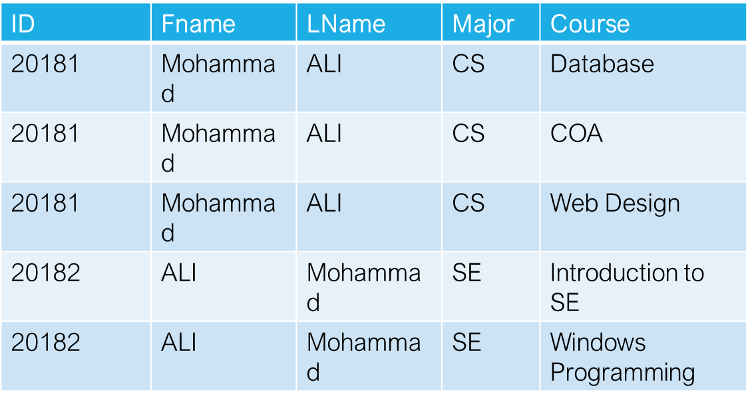
1NF Example

Slide 13
Functional Dependencies
Constraints on the set of legal relations.
Require that the value for a certain set of attributes determines uniquely the value for another set of attributes.
A functional dependency is a generalization of the notion of a key.

Slide 14
Functional Dependencies
Determines the relation of one attribute to another attribute.
Functional dependency helps you to maintain the quality of data in the database.
A functional dependency is denoted by an arrow →.
The functional dependency of X on Y is represented by X → Y.
Functional Dependency plays a vital role to find the difference between good and bad database design.

Slide 15
Inference Rule (IR)
The Armstrong's axioms are the basic inference rule.
Armstrong's axioms are used to conclude functional dependencies on a relational database.
The inference rule is a type of assertion. It can apply to a set of FD(functional dependency) to derive other FD.
Using the inference rule, we can derive additional functional dependency from the initial set.
The purpose of inference Rule is to find the candidate key, and to do the normalization of a relational schema.

Slide 16
Inference Rule (IR)
Reflexive/Trivial Rule (R.R): If Y ⊆ X then X → Y
Non-trivial FD: If a FD X → Y holds true where Y is not subset of X.
Augmentation Rule (A.R): If X → Y then XW → YW
Transitive Rule (T.R): If X → Y and Y → Z then X → Z

Slide 17
Inference Rule (IR)
Union Rule (U.R): If X → Y and X → Z, then X → YZ
Composition Rule: If X → Y Holds and R → Z Holds
then XR → YZ also Holds
Decomposition Rule(D.R): If X → Y and Z ⊆ Y
then X → Z
        OR X → YZ, then X → Y and X → Z also Holds.
Pseudo-Transitive Rule (PR): If X → Y and WY → Z
then XW → Z

Slide 18
Inference Rule (IR)
Full FD: If determinant/independent attribute functionally determines all other attributes in a table.
Partial FD: If determinant/independent attribute functionally determines some of the other attributes in a table.
Multi-valued Dependency: Exists when attribute functionally determine more than one non-key attribute.

Slide 19
Second Normal Form (2NF)
Rules of 2NF:
  Must be in 1NF.
  No partial Dependencies
    (Y is fully functionally dependent on X if X → Y and no proper subset of X functionally determines Y)

Slide 20
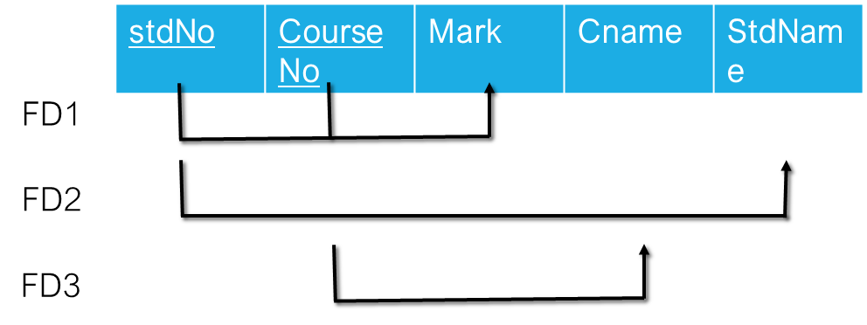
2NF Example
As you can see attribute (mark) fully dependent on the keys (stdNo, CourseNo) which is OK 2NF.
Attribute (Cname) is partially dependent on the (stdNo, CourseNo) and that is not OK with 2NF.
Attribute (stdName) is partially dependent on the (stdNo, CourseNo) and that is not OK with 2NF.
So, The Solution …..????!!!!!!!!!!

Slide 21
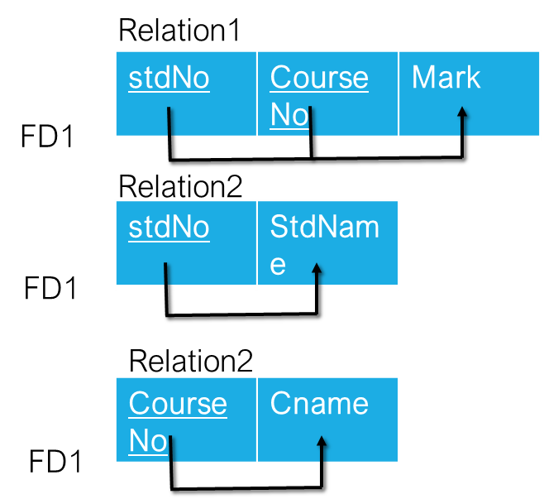
2NF Solution

Slide 22
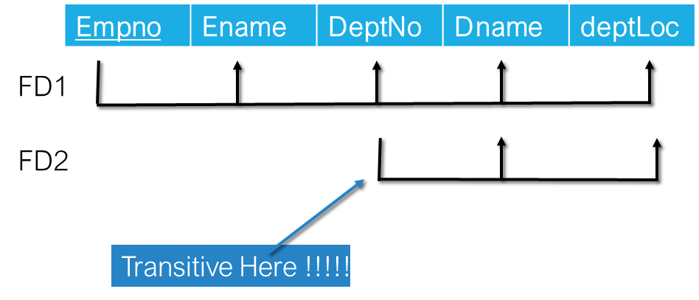
Third Normal Form (3NF)
Rules of 2NF:
  Must be in 2NF.
  No Transitive dependency

Slide 23
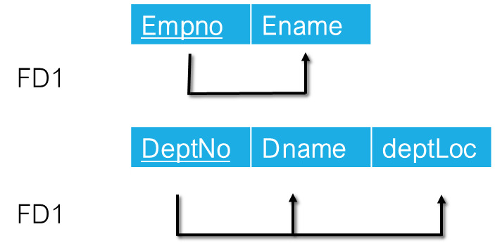
3NF Solution

Slide 24
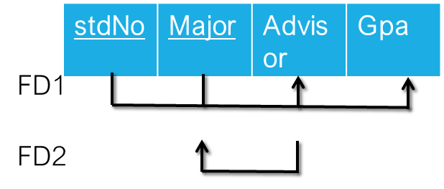
Boyce-Codd Normal Form (BCNF)
Rules of BCNF :
  Must be in 3NF.
  Attribute is fully dependent on key even if it is a key.
How to solve it to meet BCNF…!!!!!!

Slide 25
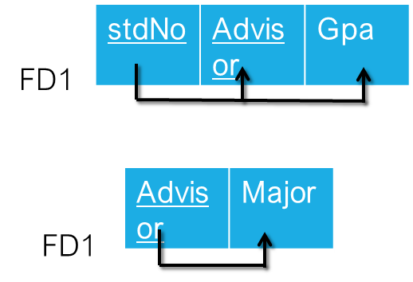
BCNF Solution

